Slide 1
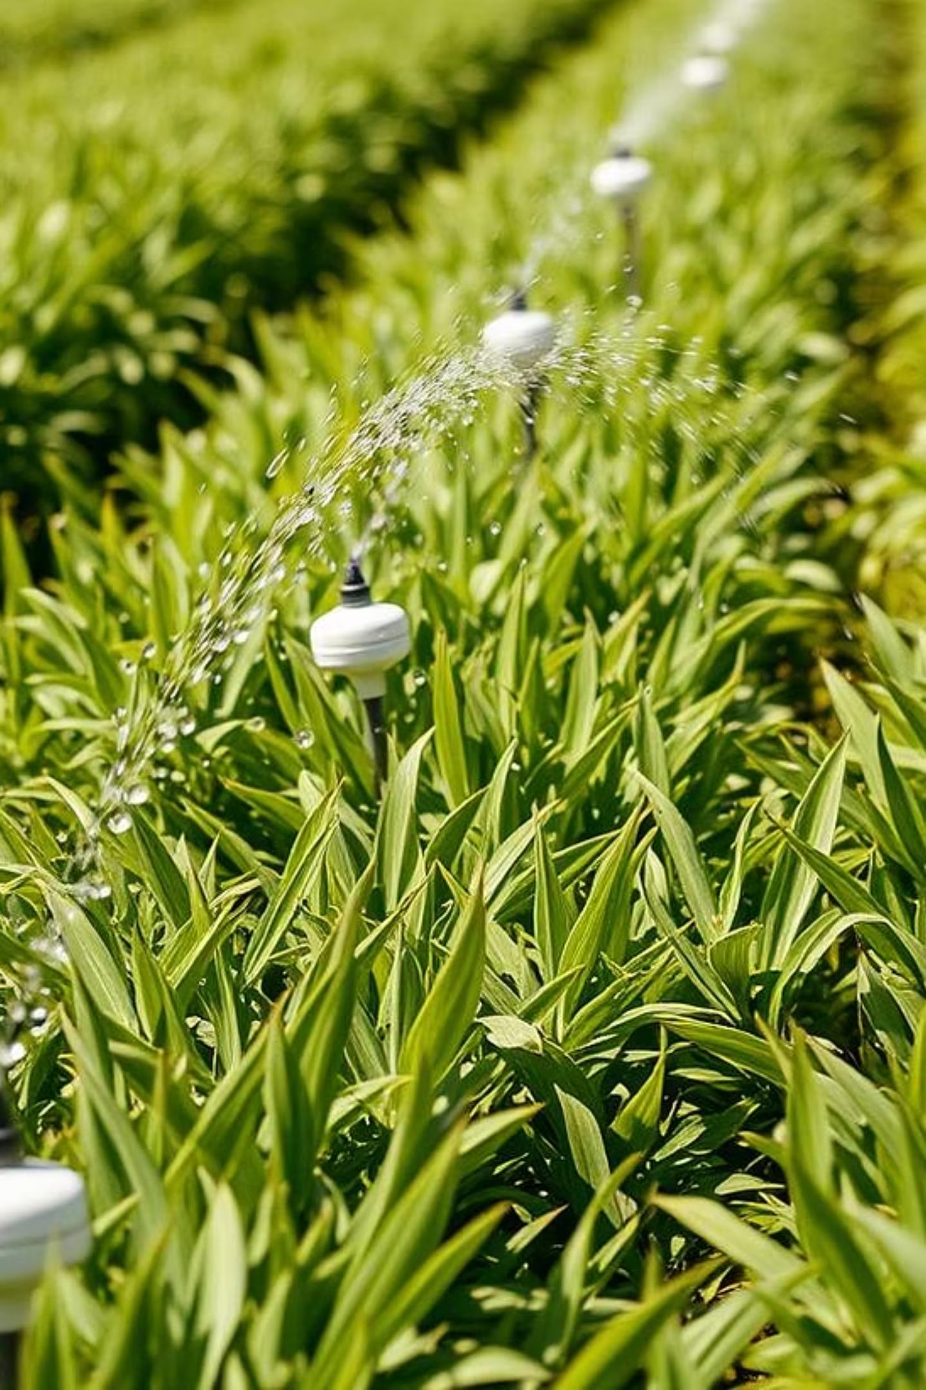
IRRIGATION SYSTEM FOR SMART FARMING USING ML AND IOT
Presented By: AJIN BIJU

Slide 2
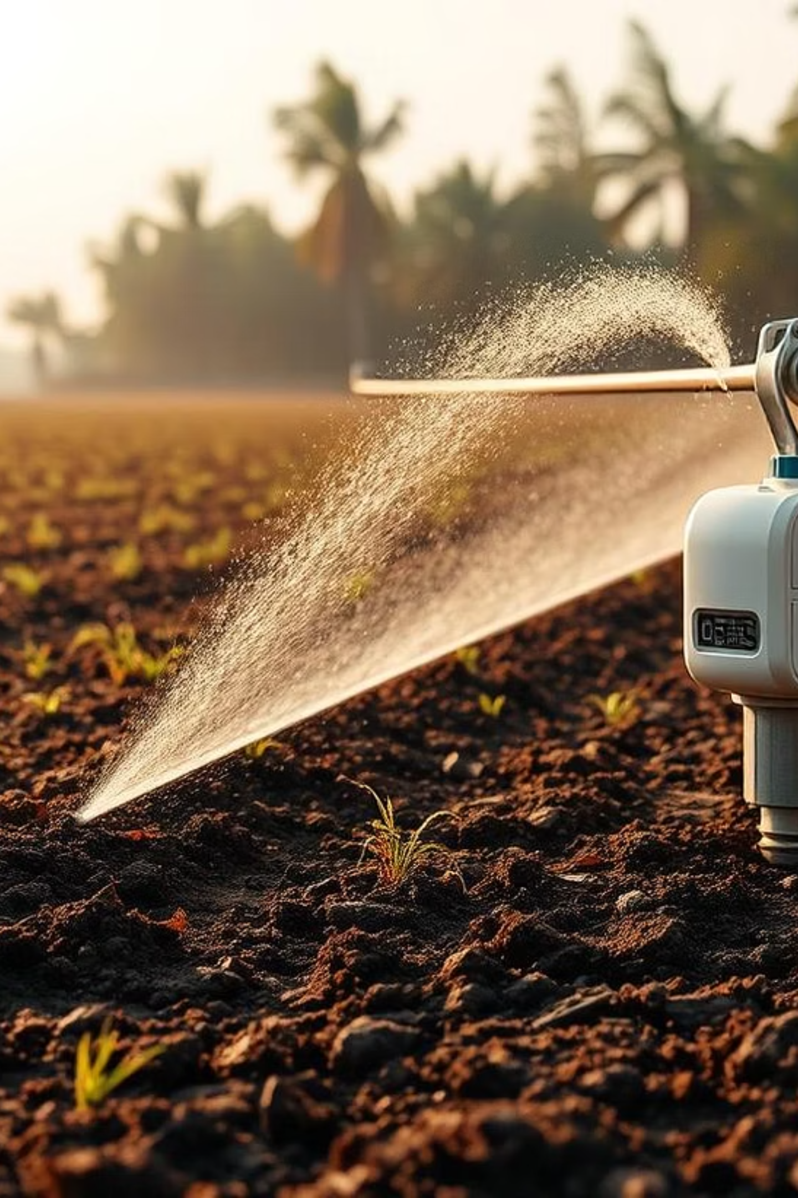
Introduction to Smart Irrigation
Smart irrigation automates watering using sensor data, combining IoT monitoring with ML decision-making. This system significantly reduces water wastage and manual labor in agriculture.

Slide 3
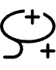


Project Objectives
Automate Irrigation
Predict Needs
Monitor System
Using real-time sensor feedback.
Leveraging machine learning for irrigation predictions.
Through intuitive IoT dashboards.

Slide 4
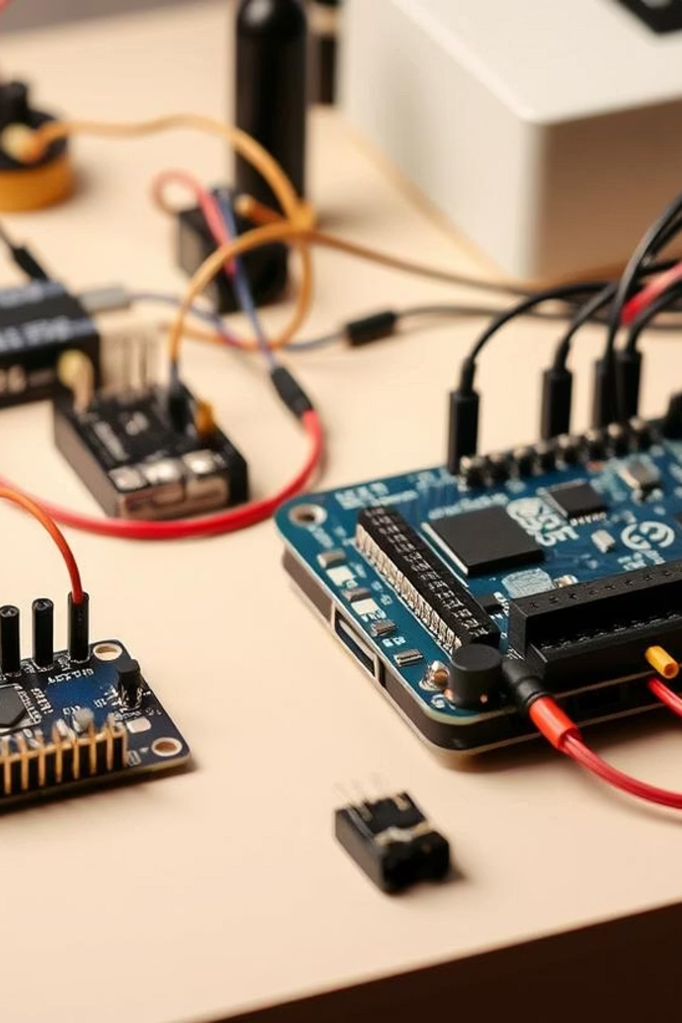
System Components
Hardware
Actuators & Connectivity
Arduino UNO / ESP32 Board
Soil Moisture Sensor
Relay Module
Temperature & Humidity Sensor (DHT22)
Water Pump
ESP8266/ESP32 for Wi-Fi IoT

Slide 5




System Architecture
Input
Processing
Soil Moisture, Temperature, Humidity Sensors
ML Prediction (Server or On-Device)
Actuation
IoT Dashboard
Relay Module controls Pump
Displays sensor data and pump status

Slide 6
Machine Learning Model
Algorithm
Training & Deployment
Decision Tree Classifier
Collected ~500 samples with labeled actions.
Inputs & Output
Model hosted on server; Arduino fetches predictions.
Inputs: Moisture, Temperature, Humidity
Output: Pump ON/OFF Decision

Slide 7
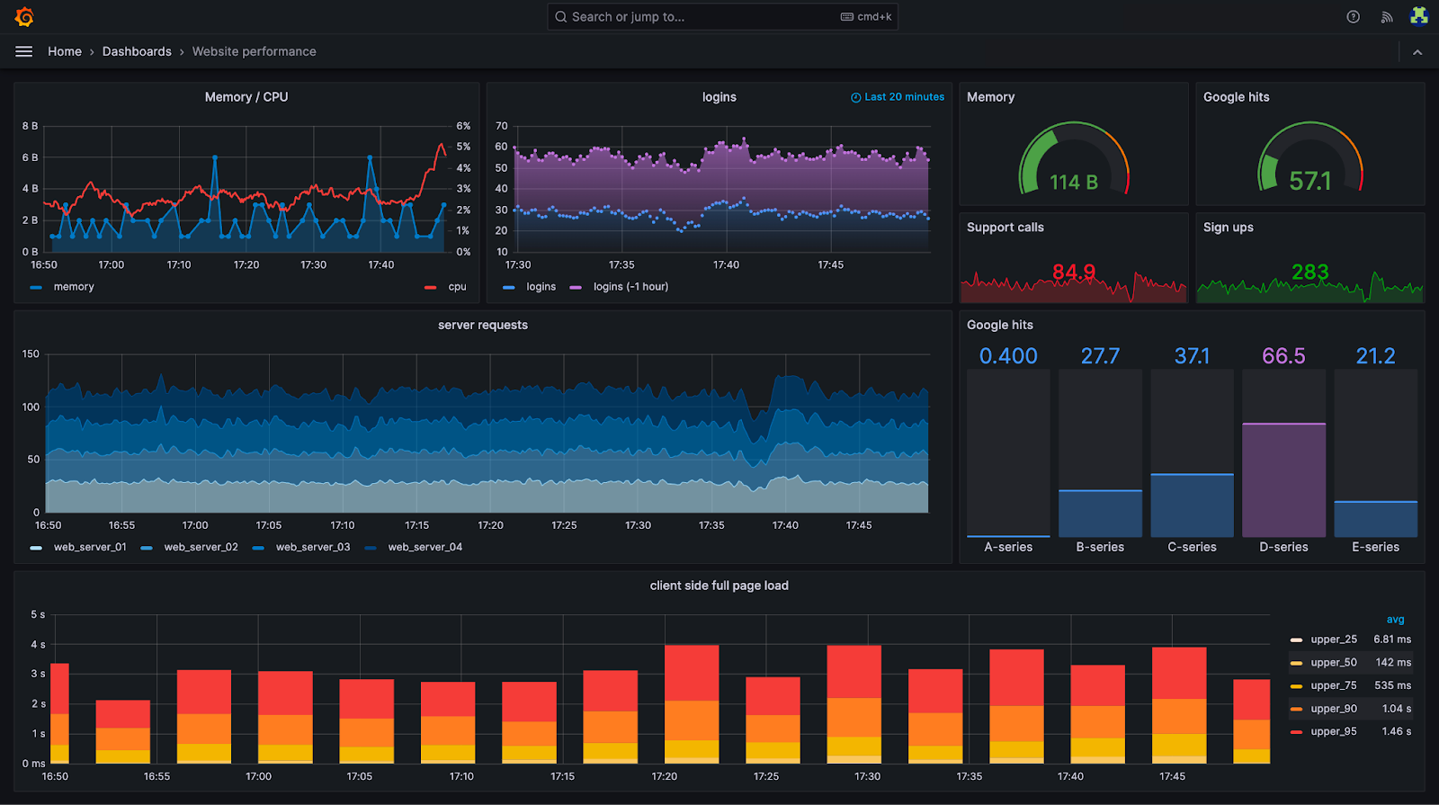
Data Recording Process
Reads sensors every 5 seconds or adjustable interval.
Checks moisture against a simple threshold.
Activates relay (pump ON/OFF).
Prints data & decision to Serial Monitor or SD card:
Record at least 200–500 rows for varied soil and weather
Ideal format (CSV):
Let Arduino send data to IoT platforms
(ThingSpeak, Blynk). Later, export the data CSV from the dashboard.

Slide 8
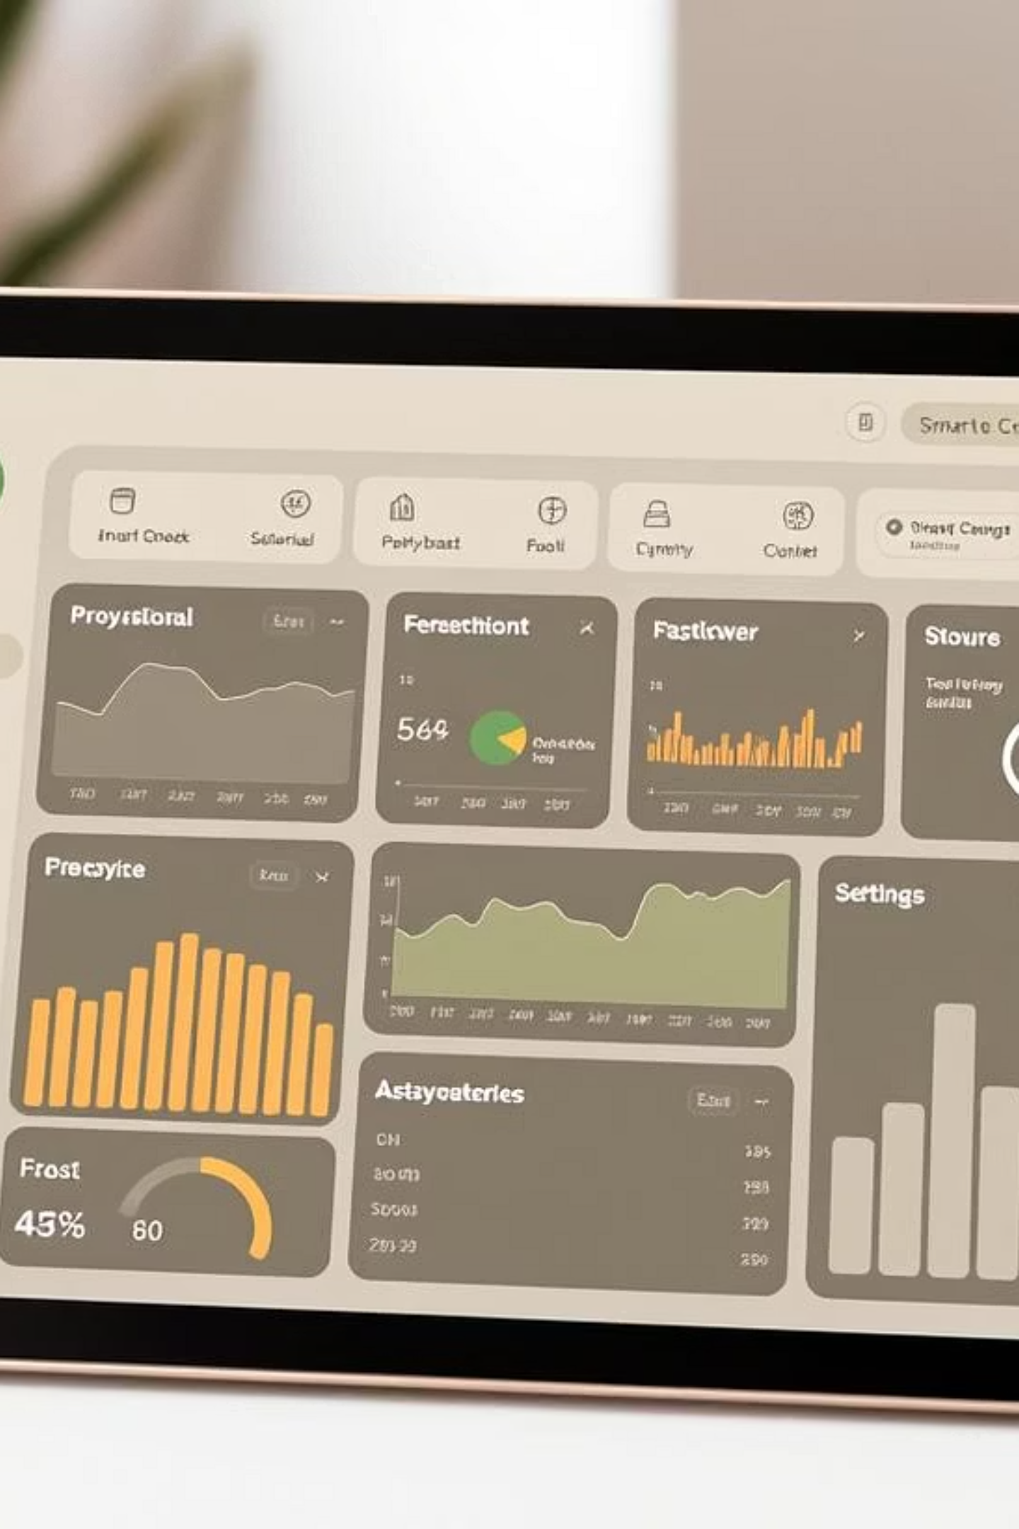
IoT Platform Integration
IoT Services
Blynk, ThingSpeak
Real-time Data
Monitors live sensor data.
Remote Control
Enables remote pump control.
Logging & Notifications
Data logging and alerts.

Slide 9




Advantages of the System
Water Conservation
Automated & Remote
Optimized watering reduces waste.
System operates autonomously with remote access.
Easy Monitoring
Scalable & Upgradable
Via smartphone or web interface.
Flexible for future enhancements.

Slide 10
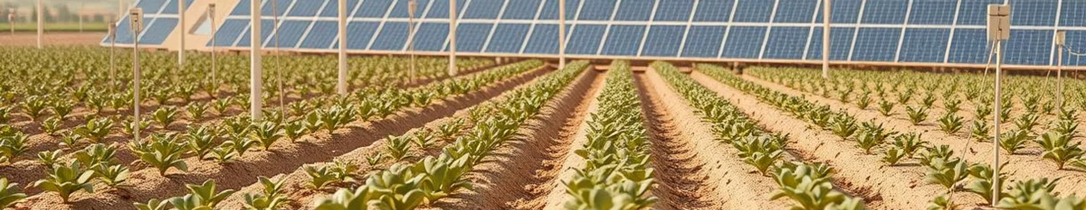
Limitations & Future Scope
Current Limitations
Future Enhancements
Requires stable Wi-Fi connection.
On-device ML with TinyML for edge processing.
Server maintenance for ML model hosting.
Integration of solar power for sustainable operation.

Slide 11
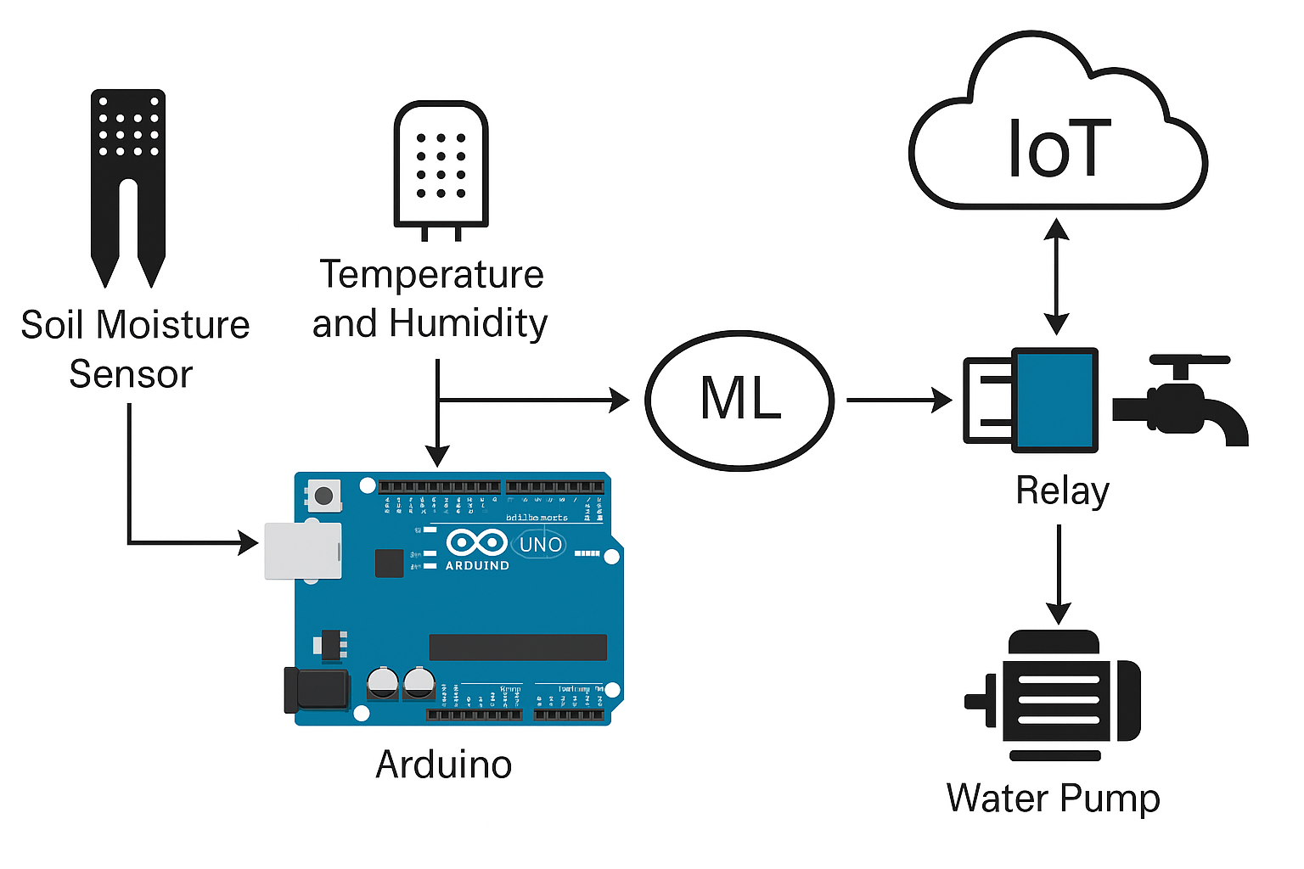
DIAGRAM

Slide 12
